Slide 1
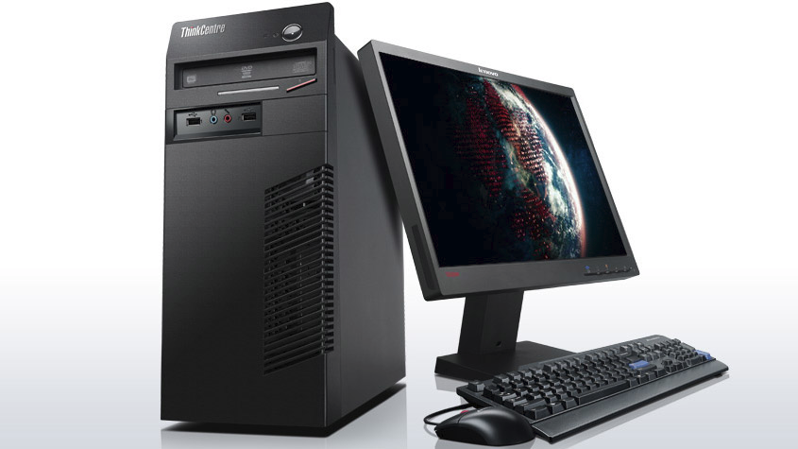
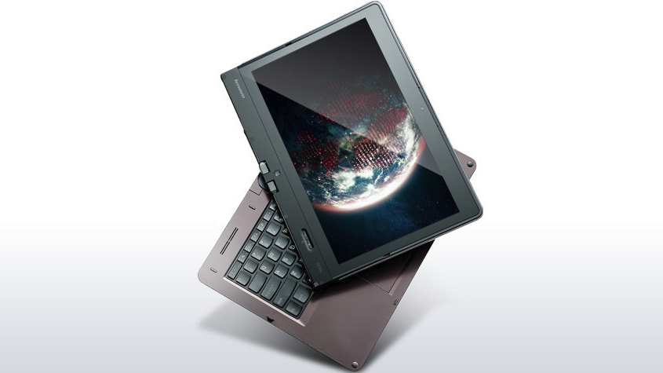
Some Deployment Scenarios
Project Staff using a Desktop
- In your building with Ethernet
Project Staff using a Laptop, Tablet, or Laptop/Tablet Hybrid
- In rural areas with a battery and a mobile 3G hotspot
Self-administered by the participant
- In any location with a modern browser

